Slide 1

Tata Motors – Business Analysis (Jan–Jun 2024)
Prepared by Bhakti

Slide 2
Introduction
Tata Motors is one of India’s leading automobile companies.
  Known for safety and innovation.
  Covers 6-month sales & expenses.

Slide 3
Company Overview
Manufactures hatchbacks, sedans, SUVs & EVs.
  Strong nationwide network.
  Popular models: Nexon, Punch, Tiago, Altroz.

Slide 4
Sales Analysis
Nexon & Punch are top sellers.
  Tiago & Altroz perform well.
  Revenue increasing monthly.

Slide 5
Sales Highlights
High demand for compact SUVs.
  Stable performance across models.
  Strong sales in urban cities.

Slide 6
Expense Analysis
Salary is major expense.
  Marketing & R&D costs rising.
  Logistics and maintenance stable.

Slide 7
Customer Insights
Customers prefer Nexon, Punch, Altroz.
  Buyers mostly from metro cities.
  Payment modes: EMI, loan, full pay.

Slide 8
Conclusion
Strong financial performance.
  Growing SUV & EV segment.
  Positive future outlook.

Slide 9
Learnings
Data analysis in Excel.
  Word reporting skills.
  Understanding business trends.

Slide 10
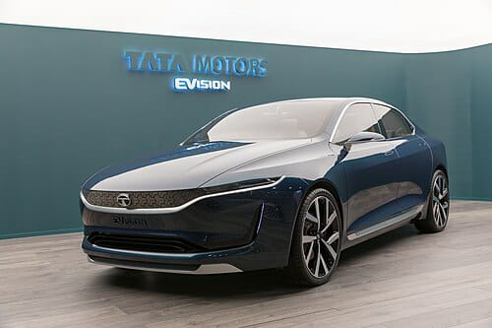
Thank You

